Slide 1
Improving Bengali Math Solutions with Multi-Agent TIR
Team
Presented By
Team_habijabi
Abir Hasan
Siam Arefin
Farzine Hossen
Tahera Jannat

Slide 2
Introduction
Dataset Analysis
Prompting
Agent
Outline
Majority Voting
Model Selection
Model Performance
Experiment
Future Scope

Slide 3
Introduction
Our task is to solving math problems in Bengali Language

Slide 4
Dataset Analysis
Contains different category problems in the train and test dataset. Such as:
Algebra
Combinatorics
Number Theory
Geometry
5. Logarithms
6. Factorials
7. Prime Number
8. Percentage
Some problems are description-type problems and some problems are equational

Slide 5
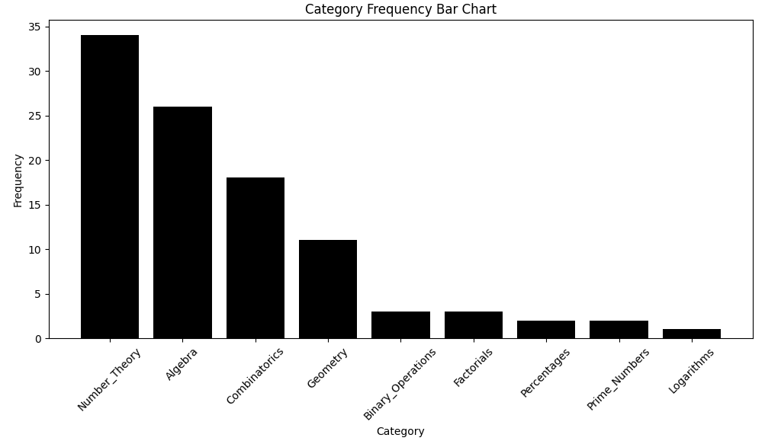
Dataset Analysis

Slide 6
Prompting
Using Zero-shot prompting implementation
Using Chain of Thaught prompting with RAG implementation
Using TIR prompting with RAG implementation

Slide 7
Agent Answer Generation
Creates multiple agents to collaboratively solve a math problem with the LLM
Guides the LLM through iterative steps to solve the problem using SymPy.
Executes and verifies generated code, providing feedback on errors or successes.
Aggregates all agents' answers and chooses the most common one as the final answer.

Slide 8
Majority Voting
Remove None values to focus only on valid answers.
Tracks how often each answer appears using a dictionary.
Finds the answer with the highest count.
Returns the most common answer or ‘Null’ if there were no valid answers.

Slide 9
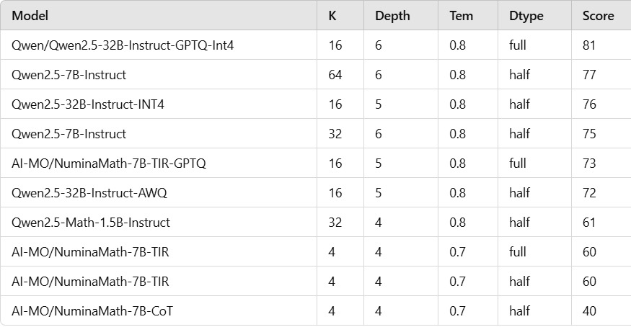
Experiment with different model and parameters

Slide 10
Model Selection
Qwen/Qwen2.5-32B-Instruct-GPTQ-Int4
Specially finetune for math problem
32 B model with quantization
Perform better than other model
Higher speed at inference time (approximately 6-7 hours)

Slide 11
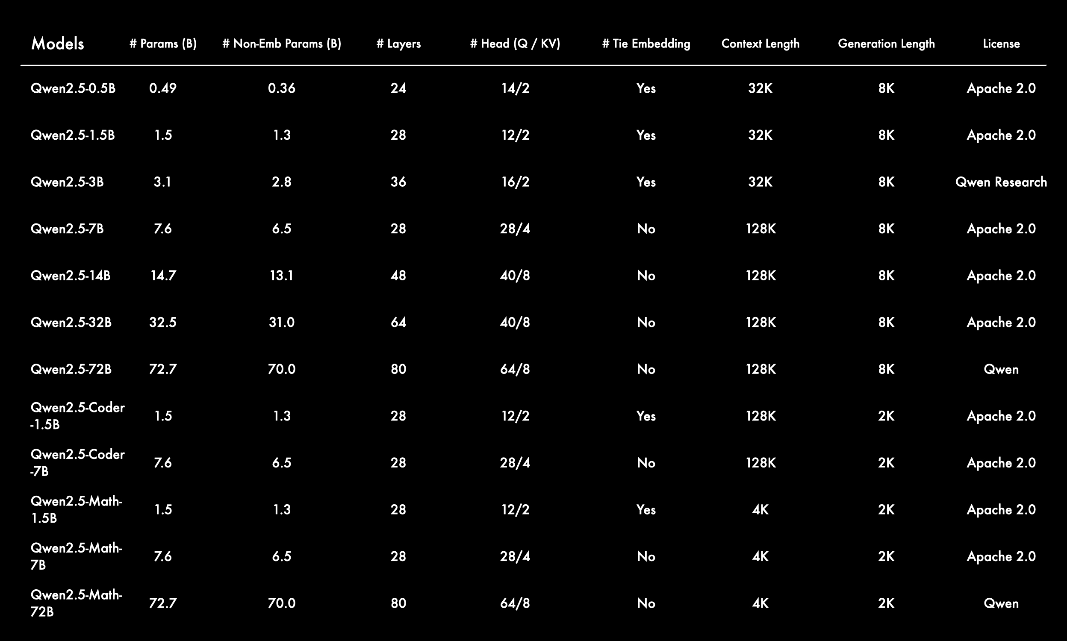
Model Performance

Slide 12
Future Scope
Finetune with a Bengali Dataset.
Explore more advanced architecture model
Improve in prompt engineering
Experiment with different parameter

Slide 13
THANK YOU!

